Slide 1
Feasibility studies

Slide 2
What is a Feasibility Study?
A feasibility study is an analysis of the viability of an idea through a disciplined and documented process of thinking through the idea from its logical beginning to its logical end.
A feasibility study provides an Investigating function that helps answer “Should we proceed with the proposed project idea? Is it a viable business venture?”
A feasibility study should be conducted to determine the viability of an idea BEFORE proceeding with the development of a business.

Slide 3
Why a feasibility study?
Objectives:
To find out if a system development project can be done:
...is it possible?
...is it justified?
To suggest possible alternative solutions.
To provide management with enough information to know:
Whether the project can be done
Whether the final product will benefit its intended users
What the alternatives are (so that a selection can be made in subsequent phases)
Whether there is a preferred alternative
A management-oriented activity:
After a feasibility study, management makes a “go/no-go” decision.
Need to examine the problem in the context of broader business strategy

Slide 4
Content of a feasibility study
Things to be studied in the feasibility study:
The present organizational system
Stakeholders, users, policies, functions, objectives,...
Problems with the present system
inconsistencies, inadequacies in functionality, performance,…
Goals and other requirements for the new system
Which problem(s) need to be solved?
What would the stakeholders like to achieve?

Slide 5
Content of a feasibility study
Constraints
including nonfunctional requirements on the system (preliminary pass)
Possible alternatives
“Sticking with the current system” is always an alternative
Different business processes for solving the problems
Different levels/types of computerization for the solutions
Advantages and disadvantages of the alternatives
Things to conclude:
Feasibility of the project
The preferred alternative.

Slide 6
Data Sources for a Feasibility Assessment
Data required for a feasibility study can come from primary or secondary sources
Primary data can include formal interviews and surveys
Collection of primary data can be expensive and time consuming
Secondary data can include industry and trade publications, statistics of industry associations, and government agency reports

Slide 7
Four Types of feasibility
Technical feasibility
Is the project possible with current technology?
What technical risk is there?
Availability of the technology:
Is it available locally?
Can it be obtained?
Will it be compatible with other systems?
Economic feasibility
Is the project possible, given resource constraints?
What are the benefits?
Both tangible and intangible
Quantify them!
What are the development and operational costs?
Are the benefits worth the costs?

Slide 8
Four Types of feasibility
Schedule feasibility
Is it possible to build a solution in time to be useful?
What are the consequences of delay?
Any constraints on the schedule?
Can these constraints be met?
Operational feasibility
If the system is developed, will it be used?
Human and social issues…
Potential labour objections?
Manager resistance?
Organizational conflicts and policies?
Social acceptability?
legal aspects and government regulations?

Slide 9
Technical Feasibility
Is the proposed technology or solution practical?
Do we currently possess the necessary technology?
Do we possess the necessary technical expertise
…and is the schedule reasonable for this team?
Is relevant technology mature enough to be easily applied to our problem?
What kinds of technology will we need?
Some organizations like to use state-of-the-art technology
…but most prefer to use mature and proven technology.
A mature technology has a larger customer base for obtaining advice concerning problems and improvements.
Is the required technology available “in house”?
If the technology is available:
…does it have the capacity to handle the solution?
If the technology is not available:
…can it be acquired?

Slide 10
Economic Feasibility
Can the bottom line be quantified yet?
Very early in the project…
a judgment of whether solving the problem is worthwhile.
Once specific requirements and solutions have been identified…
…the costs and benefits of each alternative can be calculated
Cost-benefit analysis
Purpose - answer questions such as:
Is the project justified (I.e. will benefits outweigh costs)?
What is the minimal cost to attain a certain system?
How soon will the benefits accrue?
Which alternative offers the best return on investment?
Examples of things to consider:
Hardware/software selection
Selection among alternative financing arrangements (rent/lease/purchase)
Difficulties
benefits and costs can both be intangible, hidden and/or hard to estimate
ranking multi-criteria alternatives

Slide 11
Benefits Costs
Tangible Benefits
Readily quantified as $ values
Examples:
increased sales
cost/error reductions
increased throughput/efficiency
increased margin on sales
more effective use of staff time
Intangible benefits
Difficult to quantify
But maybe more important!
business analysts help estimate $ values
Examples:
increased flexibility of operation
higher quality products/services
better customer relations
improved staff morale
How will the benefits accrue?
When - over what timescale?
Where in the organization?
Development costs (OTO)
Development and purchasing costs:
Cost of development team
Consultant fees
software used (buy or build)?
hardware (what to buy, buy/lease)?
facilities (site, communications, power,...)
Installation and conversion costs:
installing the system,
training personnel,
file conversion,....
Operational costs (on-going)
System Maintenance:
hardware (repairs, lease, supplies,...),
software (licenses and contracts),
facilities
Personnel:
For operation (data entry, backups,…)
For support (user support, hardware and software maintenance, supplies,…)
On-going training costs

Slide 12
Example: costs for small Client-Server project

Slide 13
Analyzing Costs vs. Benefits
Identify costs and benefits
Tangible and intangible, one-time and recurring
Assign values to costs and benefits
Determine Cash Flow
Project the costs and benefits over time, e.g. 3-5 years
Calculate Net Present Value for all future costs/benefits
determines future costs/benefits of the project in terms of today's dollar values
A dollar earned today is worth more than a potential dollar earned next year
Do cost/benefit analysis
Calculate Return on Investment:
Allows comparison of lifetime profitability of alternative solutions.
ROI = Total Profit = Lifetime benefits - Lifetime costs
Total Cost Lifetime costs
Calculate Break-Even point:
how long will it take (in years) to pay back the accrued costs:
@T (Accrued Benefit > Accrued Cost)

Slide 14
Calculating Present Value
A dollar today is worth more than a dollar tomorrow…
Your analysis should be normalized to “current year” dollar values.
The discount rate
measures opportunity cost:
Money invested in this project means money not available for other things
Benefits expected in future years are more prone to risk
This number is company- and industry-specific.
“what is the average annual return for investments in this industry?”
Present Value:
The “current year” dollar value for costs/benefits n years into the future
… for a given discount rate i
1
Present_Value(n) = (1 + i)^{n}
E.g. if the discount rate is 12%, then
Present_Value(1) = 1/(1 + 0.12)¹ = 0.893
Present_Value(2) = 1/(1 + 0.12)² = 0.797

Slide 15
Net Present Value
Measures the total value of the investment
…with all figures adjusted to present dollar values
NPV = Cumulative PV of all benefits - Cumulative PV of all costs
Assuming subsequent years are like year 4…
the net present value of this investment in the project will be:
after 5 years, $13,652
after 6 years, $36,168

Slide 16
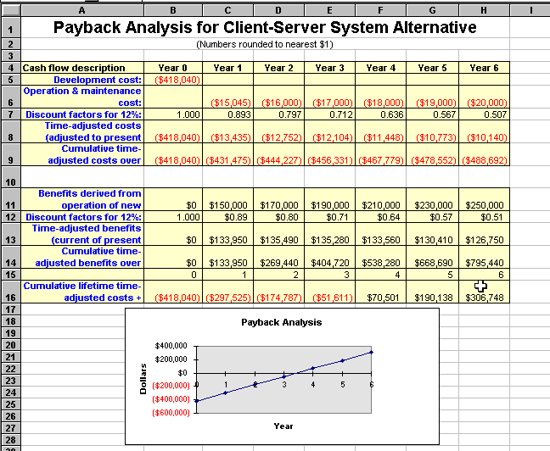

Slide 17
Computing the payback period
Can compute the break-even point:
when does lifetime benefits overtake lifetime costs?
Determine the fraction of a year when payback actually occurs:
| beginningYear amount |
endYear amount + | beginningYear amount |
For our last example, 51,611 / (70,501 + 51,611) = 0.42
Therefore, the payback period is approx 3.4 years

Slide 18
Return on Investment (ROI) analysis
For comparing overall profitability
Which alternative is the best investment?
ROI measures the ratio of the value of an investment to its cost.
ROI is calculated as follows:
ROI = Estimated lifetime benefits - Estimated lifetime costs Estimated lifetime costs
or:
ROI = Net Present value / Estimated lifetime costs
For our example
ROI = (795,440 - 488,692) / 488,692 ≈ 63%,
or ROI = 306,748 / 488,692 ≈ 63%
Solution with the highest ROI is the best alternative
But need to know payback period too to get the full picture
E.g. A lower ROI with earlier payback may be preferable in some circumstances

Slide 19
Schedule Feasibility
How long will it take to get the technical expertise?
We may have the technology, but that doesn't mean we have the skills required to properly apply that technology.
May need to hire new people
Or re-train existing systems staff
Whether hiring or training, it will impact the schedule.
Assess the schedule risk:
Given our technical expertise, are the project deadlines reasonable?
If there are specific deadlines, are they mandatory or desirable?
If the deadlines are not mandatory, the analyst can propose several alternative schedules.
What are the real constraints on project deadlines?
If the project overruns, what are the consequences?
Deliver a properly functioning information system two months late…
…or deliver an error-prone, useless information system on time?
Missed schedules are bad, but inadequate systems are worse!

Slide 20
Operational Feasibility
How do end-users and managers feel about…
…the problem you identified?
…the alternative solutions you are exploring?
You must evaluate:
Not just whether a system can work…
… but also whether a system will work.
Any solution might meet with resistance:
Does management support the project?
How do the end users feel about their role in the new system?
Which users or managers may resist (or not use) the system?
People tend to resist change.
Can this problem be overcome? If so, how?
How will the working environment of the end users change?
Can or will end users and management adapt to the change?

Slide 21
Writing Feasibility Reports
INTRODUCTION:
Include the statement of the problem. Subject and purpose of the study and its authorization.
BACKGROUND:
Circumstances that created the necessity for this study.
DISCUSSION:
The technical and financial feasibility analysis. Individual analysis of each alternative or proposed activities.

Slide 22
Use facts, data, calculations, graphics to explain your analysis and conclusions.
CONCLUSIONS:
The natural results from the information presented in the discussion. This section is the link between the discussion and the recommendation.
RECOMMENDATIONS:
Give recommendations about the most suitable option. Also, elaborate on its feasibility.

Slide 23
Feasibility Study Contents
Purpose & scope of the study
Objectives (of the study)
who commissioned it & who did it,
sources of information,
process used for the study,
how long did it take,…
Description of present situation
organizational setting, current system(s).
Related factors and constraints.
Problems and requirements
What’s wrong with the present situation?
What changes are needed?
Objectives of the new system.
Goals and relationships between them
Possible alternatives
…including ‘do nothing’.
Criteria for comparison
definition of the criteria
Analysis of alternatives
description of each alternative
evaluation with respect to criteria
cost/benefit analysis and special implications.
Recommendations
what is recommended and implications
what to do next;
E.g. may recommend an interim solution and a permanent solution
Appendices
to include any supporting material.

Slide 24
Comparing Alternatives
How do we compare alternatives?
When there are multiple selection criteria?
When none of the alternatives is superior across the board?
Use a Feasibility Analysis Matrix!
The columns correspond to the candidate solutions;
The rows correspond to the feasibility criteria;
The cells contain the feasibility assessment notes for each candidate;
Each row can be assigned a rank or score for each criterion
e.g., for operational feasibility, candidates can be ranked 1, 2, 3, etc.
A final ranking or score is recorded in the last row.
Other evaluation criteria to include in the matrix
quality of output
ease of use
vendor support
cost of maintenance
load on system

Slide 25
Example matrix

Slide 28
The yardstick approach
Comparison of alternatives
Organize comparison by topic OR by complete subject

Slide 29
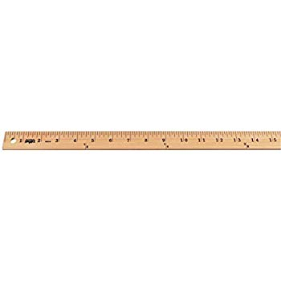
Yardstick Approach
It is used when you have various alternatives or more than one possible solution.
You will give your opinion about each alternative or solution after a thorough evaluation.
Evaluation refers to a judgment of the merit, worth, or value of something based on sound criteria.
The criteria become the yardstick by which you measure various alternatives

Slide 30

Yardstick Approach
Thus, you first need to prepare a list of criteria (factors by which you judge)
This approach is more common in feasibility reports, evaluation reports, recommendation reports.

Slide 31
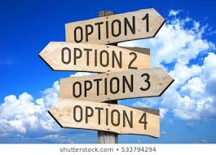
How to build the Yardstick/Criteria
The criteria should be based on the FOUR types of feasibilities which are
Economic (costs-benefits analysis)
Technical (equipment and personnel expertise)
Schedule
Operational

Slide 32

Format for Feasibility Studies Based on the Yardstick Approach
Introduction (who commissioned the report, purpose of the report, issues faced)
Evaluation Criteria
Analysis of Each Option
Conclusion and Recommendation

